Slide 1

Use machine learning to find patterns of similar eligibility protocol criteria for clinical trials
Gil Alterovitz, PhD, FACMI and
Justin Koufopoulos
Presidential Innovation Fellows

Slide 2

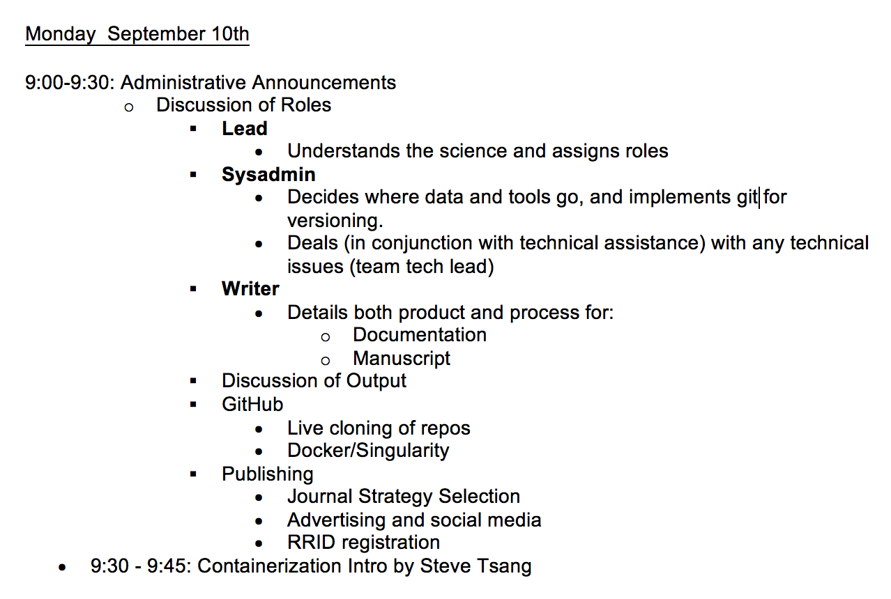
Schedule

Slide 3
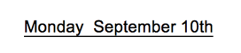
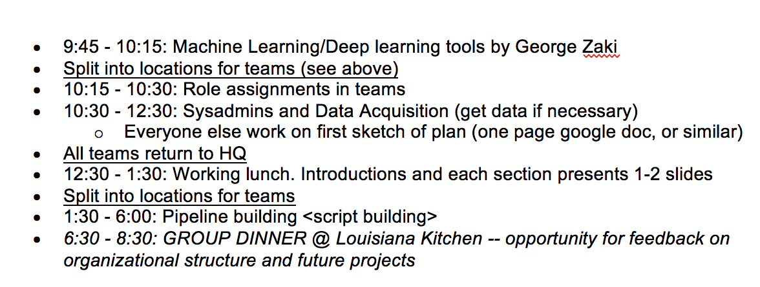
Schedule

Slide 4
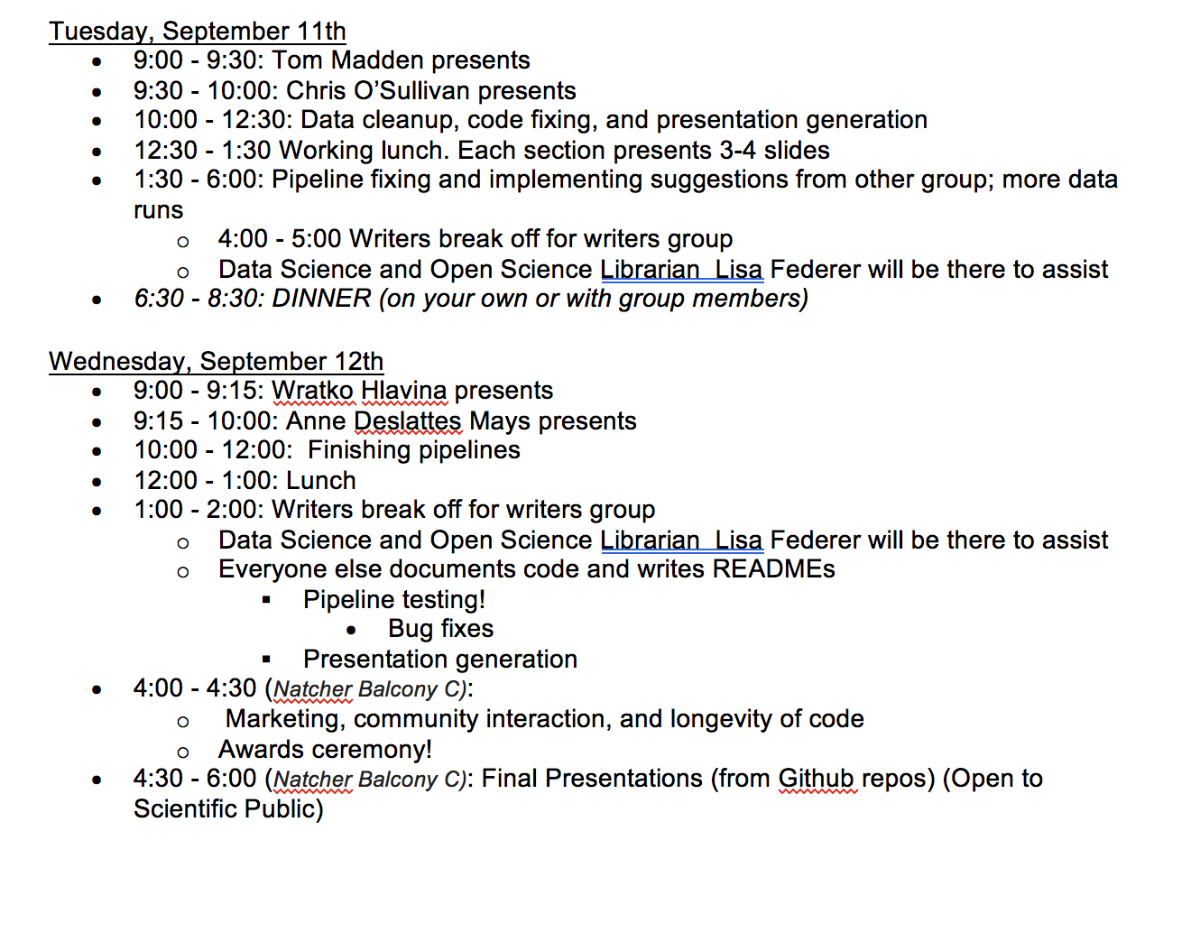
Schedule

Slide 5
Team
What is your name (first and last)? | What is your email address? | What is your github username?
Kelechi Mezu | nina.mezu@nih.gov | ninabina921
Sujatha Koganti | sujatha.koganti@nih.gov | chantcard
Christopher Lavender | christopher.lavender@nih.gov | lavenderca
Julio Marco Pineda | juliomarco.pineda@nih.gov | juliomarcopineda
Max Serpe | max.serpe@gmail.com | maxSerpe
Jia-Ling Lin | jllin@intra.nida.nih.gov | linjialing
Gil Alterovitz | gil.alterovitz@pif.gov | gilusa
Justin Koufopoulos | justin.koufopoulos@pif.gov | jkoufopoulos

Slide 6

Use Case: Make finding clinical trials easy for patients
P R E S I D E N T I A L I N N O V A T I O N F E L L O W S | pif.gov | @innovfellows

Slide 7
Approach: Reducing clinical trial recruitment burden by making data more machine-readable and leveraging NLP
P R E S I D E N T I A L I N N O V A T I O N F E L L O W S | pif.gov | @innovfellows

Slide 8
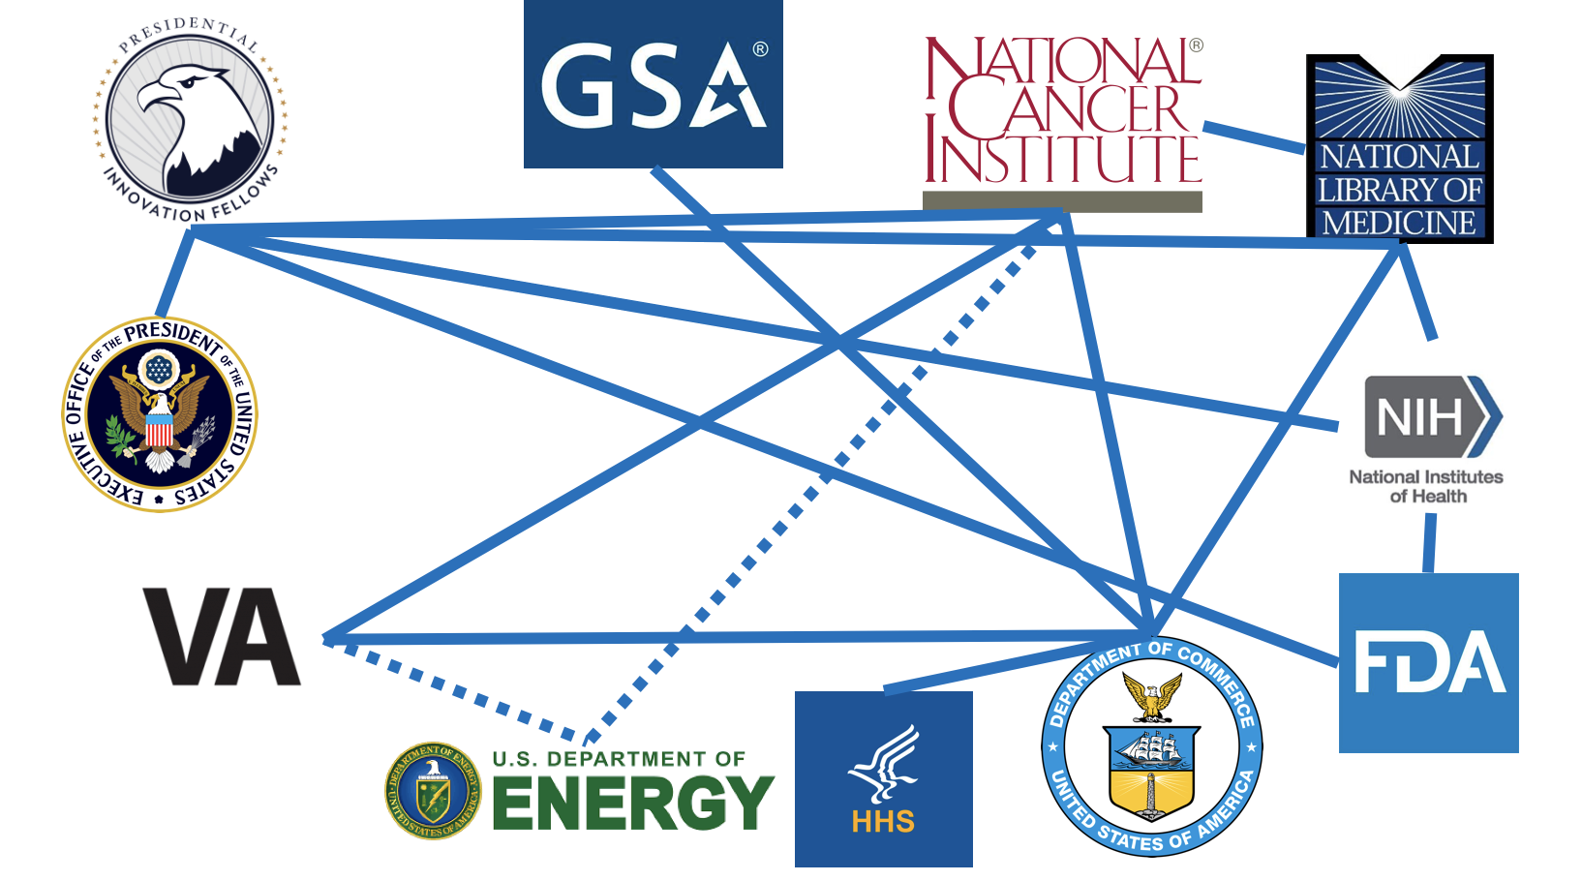

Slide 9
Gold Data Sets for Matching: Structuring Criteria and Participant Information via Terminology and Logic
Data Set 1: Eligibility Criteria
Source: (Clinical Trials Reporting Program) CTRP trials from 342 trials open to accrual Oct. 2017
Type: NCI Enterprise Vocabulary Services (EVS) coded data, Boolean expressions
HIV, Hemoglobin, Platelets, and White blood cell count
Data Set 2: Participants Data
Source: 100 participants based on contact center phone calls
Type: EVS coded data (Boolean)
Cancer Site (Primary), Cancer Type, Stage, Cell Type, Grade, State/Institution/City, ZIP Code, Type of Trial, Treatment History
Trials with Therapies
Match?
Patients
Eligibility criteria from clinical trial protocols
Needs, Preferences, and disease characteristics

Slide 10
Need clarity and uniformity to facilitate NLP/AI
Eligibility language is not structured
Eligibility language is complex: text can be confusing for humans (and machines)
Eligibility language is not standardized
Inclusion Criteria:
For pre-surgical patients
Suspected diagnosis of resectable non-small cell lung cancer; cancers with a histology of "adenosquamous" are considered a type of adenocarcinoma and thus a "nonsquamous" histology; patients with squamous cell carcinoma are eligible only if the registering site has EA5142 Institutional Review Board (IRB) approved
Suspected clinical stage of IIIA, II (IIA or IIB) or large IB (defined as size >= 4cm); Note: IB tumors < 4cm are NOT eligible; stage IB cancer based on pleural invasion is not eligible unless the tumor size is >= 4cm
For post-surgical patients
Completely resected non-small cell lung cancer with negative margins (R0); patients with squamous cell carcinoma are eligible only if the registering site has EA5142 IRB approved
Pathologic stage IIIA, II (IIA or IIB) or large IB (defined as size >= 4 cm); Note: IB tumors < 4cm are NOT eligible; stage IB cancer based on pleural invasion is not eligible unless the tumor size is >= 4cm
Eastern Cooperative Oncology Group (ECOG) performance status 0-1
No patients who have received neoadjuvant therapy (chemo- or radio-therapy) for this lung cancer
No locally advanced or metastatic cancer requiring systemic therapy within 5 years prior to registration; no secondary primary lung cancer diagnosed concurrently or within 2 year prior to registration
No prior treatment with agents targeting EGFR mutation, ALK rearrangement, and PD-1/PD-L1/CTLA-4
No patients known to be pregnant or lactating
Patients who have had local genotyping are eligible, regardless of the local result
No patients with recurrence of lung cancer after prior resection
Note: Post-surgical patients should proceed to registration immediately following preregistration
Completely resected NSCLC with negative margins (R0); cancers with a histology of "adenosquamous" are considered a type of adenocarcinoma and thus a "nonsquamous" histology; patients with squamous cell carcinoma are eligible only if the registering site has EA5142 IRB approved

Slide 11
Structuring Eligibility – Example: Platelets with NCI Thesaurus Terms
Encode With Logic
Platelet count greater than or equal to 100,000 platelets per cubic millimeter
Platelet ≥ 100,000/mm^3
NCIt Code: C51951 ≥ 100,000 UCUM Code: /mm^3)
Criteria Fill-in Template
Platelet count greater than or equal to _100,000__ platelets per cubic millimeter ___without_transfusion___.

Slide 12
Potential Uses for AI/NLP in Patient/Trial Matching
Matching patients to trials: Match patients to trials based on eligibility criteria/patient information (and vice versa).
Standardized protocol templates: Take text (and/or structured eligibility criteria) and cluster to find templates that can be used to in future to standardize protocols when they are initially written for a trial.
Curator assistant: Use NLP to produce suggested structured ontological concepts and logic for curators to consider when doing manual curation (e.g. for Clinical Trials Reporting Program)
Patient data: Use NLP to extract concepts form patient data that could be used for matching to trials.
Chatbots: Use speech recognition, voice synthesis, and NLP for protocol text/structured eligibility criteria to engaging patients looking for trials.

Slide 13
How can we incentivize standardization via NLP?
Challenges:
Field is evolving (new treatments)
There is no incentive for writers of protocols to structured language
Doing structuring after protocols are submitted is hard (may not know original meaning of the writer). Hard to scale curation for all criteria
NLP/AI not perfect for predicting structure
Potential Solution:
Use AI/NLP to present templates with data-based consensus options (based on text and frequency of already used in trials database so far) at the Point-of-need (i.e. when originally writing the trial).
Incentivize via 1) templates to make writing protocols faster and 2) consensus scoring to encourage standardization.
Create database for standardized phrases/criteria and variants (which can be more easily structured)
Potential Outcome:
This gradually leads to standardization in writing protocols for most criteria, thereby making curation/structuring much more scalable (since only have to do a few standard cases as well as much fewer special cases).

Slide 14
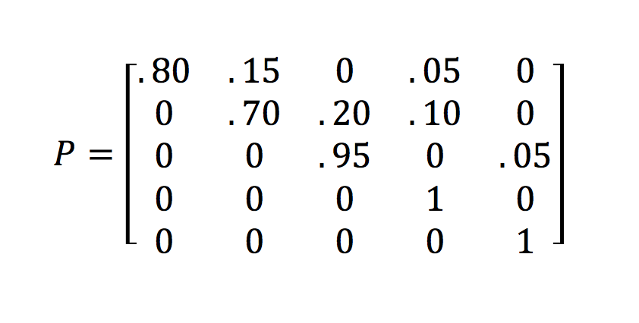
Incentivization for Standardization Framework: Absorption Markov Chain via Consensus Score
Absorption Markov Chain:
After n->infinite transitions on transition matrix with:
will tend to reach an absorption state.
Law Firm Example:
Initial state: Junior
Absorption states: Leave without getting partner. Leave as partner.

Slide 15
NIH Data Science Hackathon Goal: Toward Structured Protocol Authoring Standards and Templates
AI for Data-based Protocol Standardization
Load in criteria text: e.g. all 342 Cancer Therapy Evaluation Program (CTEP) trials.
Cluster based on similarity (e.g. semantics/entity/logical expression) to find patterns.
Extract popular templates with options for curators to select from (with frequency of popularity).

Slide 16
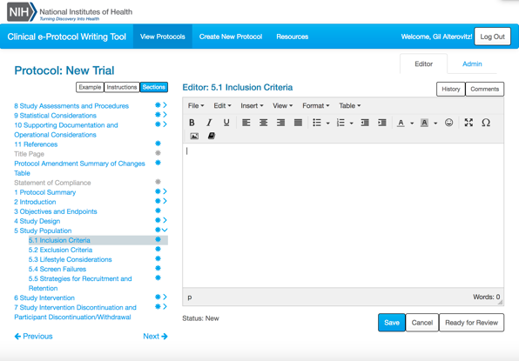
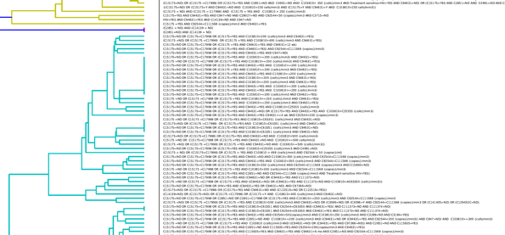
Consider how ideas, particularly in science and technology can be piloted quickly and efficiently
Bringing together government (e.g. VA, GSA, NIH, FDA), Academia, Industry
Using AI to incentivize good practice in clinical trials

Slide 17
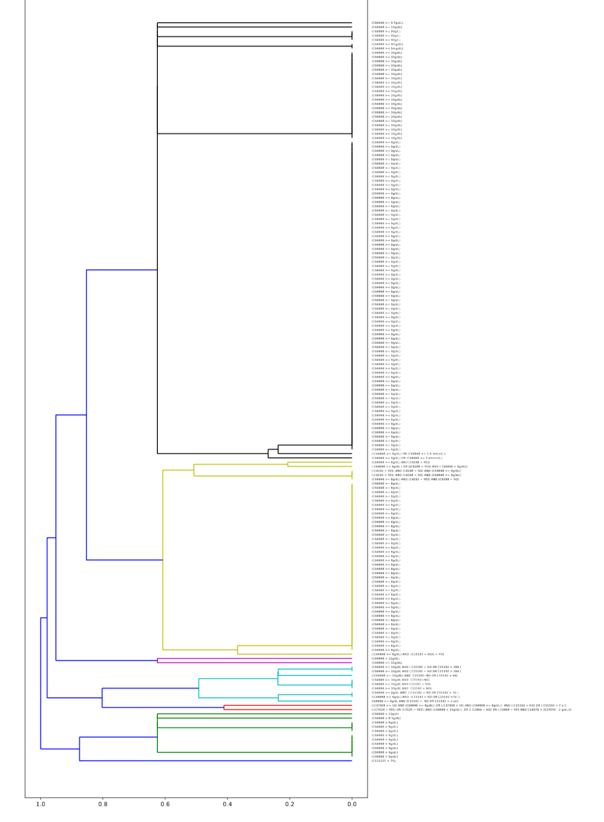
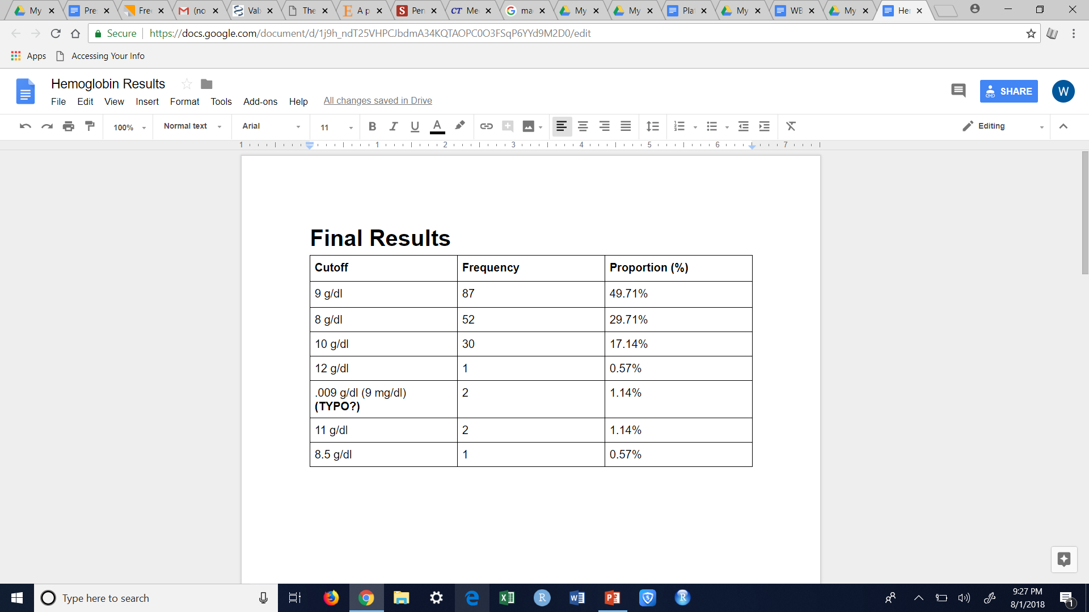
Unsupervised Learning: Clustering Logic Statements
Hemoglobin Criteria Clusters
Hemoglobin Criteria Frequencies
Hgb ≥ 9 g/dL
Hgb ≥ 8 g/dL
Additional constraints: No transfusion in past 28 days

Slide 18
Standardizing via Alternatives and Consensus Score: Change in Phrasing/Semantics
Find Template in Source Text:
Signed, dated informed consent.
Signed, written informed consent.
Written informed consent.
…
Template:
_________ informed consent
Output Fill-ins/Score:
Signed, dated / 30
Signed, written / 25
Signed / 2
Written / 100
Fill-In
Written
informed consent.
Criteria ID: 40.2 Score: 90
Criteria ID: 40.2 Score: 0.4
Consensus Score: 45
Signed, written 25
Signed 2
100
Signed, dated 30
Template
Alternatives
Score (based on frequency)

Slide 19
Fill-In
Written
informed consent.
Criteria ID: 40.2 Score: 90
Criteria ID: 40.2 Score: 0.4
Consensus Score: 45
Signed, written 25
Signed 2
100
Signed, dated 30
Template
Score (based on frequency, study size, etc)
Alternatives

Slide 20
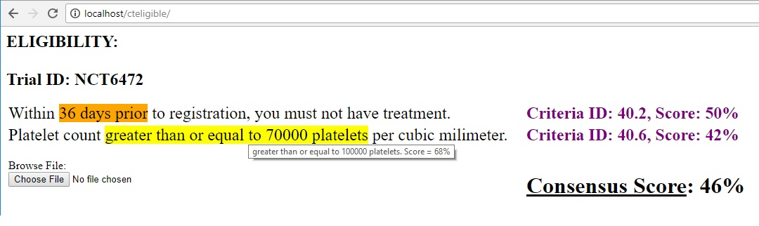
Standardizing via Alternatives and Consensus Score: Change in Phrasing/Semantics
Template variant ID
Template score
Written
informed consent.
Criteria ID: 40.2 Score: 100
Criteria ID: 40.2 Score: 1
Consensus Score: 45
100
Platelets greater than or equal to per cubic millimeter.
75,000 19
50,000 11
100,000 100
Overall Score

Slide 21
Cluster 1
All Criteria (across all trials)
.
.
.
Cluster 2
Cluster Platelet1
(Text +
Criteria Instance Score)
Template Platelet1 + Fill-ins + Blank Instance
Scores
.
.
.
Cluster N

Slide 22
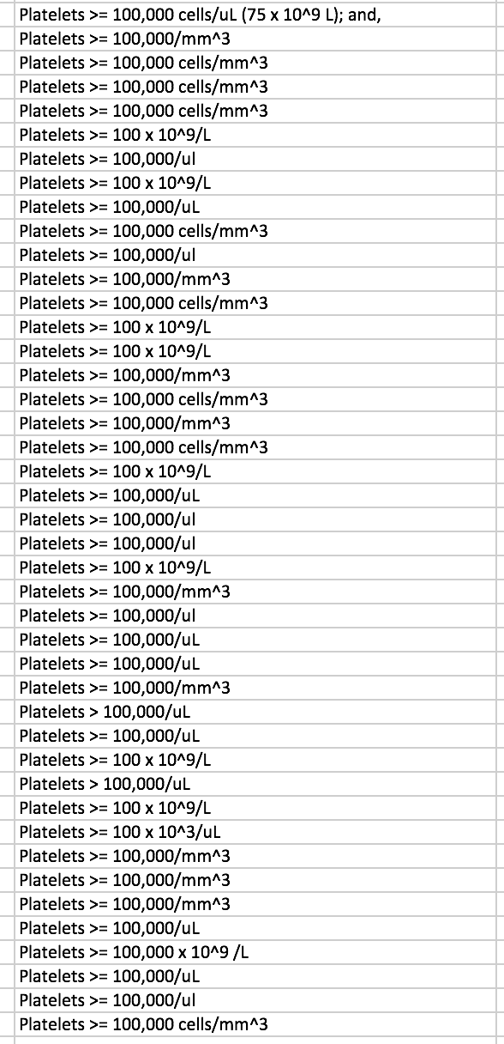
Cluster Platelet1

Slide 23
Cluster Platelet1
Criteria Category
Lab test -> Platelets (e.g. NCIt term: C51951)
Platelets | > | ___Blank 1___ | 100 | __Blank 2___
Template:
Blank 1 | Frequency
= | 41
 | 2
Blank 2 | Frequency
000/ul | 15
000/mm 3 | 9
000 cells/mm 3 | 8
x 10 9 /l | 8
000 cells /ul 75 x 10 9 /l and | 1
Fill-ins:

Slide 24
Info
Template Rank in
Criteria Category: 1
Suggested Data-based Text: Platelets >= 100,000/ul
Guidelines to flag: CTEP -> generic protocol text YYY

Slide 25
In Background
Structured info (e.g.): C51951 >= 100000 / uL
Templates, Fill-ins,
Blank instance scores, Scores: See previous slides

Slide 26
Plan
Get code from Emmanuel working locally on your computer
Examine programming annotation software (e.g. http://annotatorjs.org/)
Generate UI based on slides
Load in clusters into backend, templates, fillins, scores, etc
Show best from closest cluster as recommendation- with fill-ins marked and selectable (plus user can put in own choices/do outside edits)
User can paste in text and interface annotates it and scores it (plus lets user pick alternatives)
Optional: Integration into Word
Integrate with CTEP template rules (https://tinyurl.com/y8r44aou), e-protocols/API (https://e-protocol.od.nih.gov/index.html)

Slide 27
Ongoing/Future work
Categorize clusters based on semantics
Examine optimal clustering parameters, super-clusters, etc.
Disease-specific metrics
Tool for protocol writers (makes recommendations based on guidelines (CTEP/ASCO friends, etc), data-based consensus, etc)
Recruitment interactive “simulation” during protocol authoring (e.g. on data warehouse or sample open data). Can be used as evidence for protocol submissions to justify accrual timelines, etc
VA EHR templates

Slide 29
U.S. Data Innovation Day 2018
Thursday, September 13, 2018 from 1 PM - 5 PM at the District Architecture Center (421 7th St NW, Washington, DC 20004)
https://www.eventbrite.com/e/us-data-innovation-day-2018-the-future-of-data-driven-medicine-tickets-48063409953
“The Future of Data-Driven Clinical Trials” Panel from 2:40 PM - 3:50 PM, Sept 13, 2018, 421 7th St NW, Washington, DC 20004
Gil Alterovitz (NCI)
Nate Crisel (VP, Real World Analytics, Astellas Pharma)
Faisal Khan (Executive Director, Advanced Analytics and AI, AstraZeneca)
Ed Ingenito (Executive Medical Director, Vertex).

Slide 30
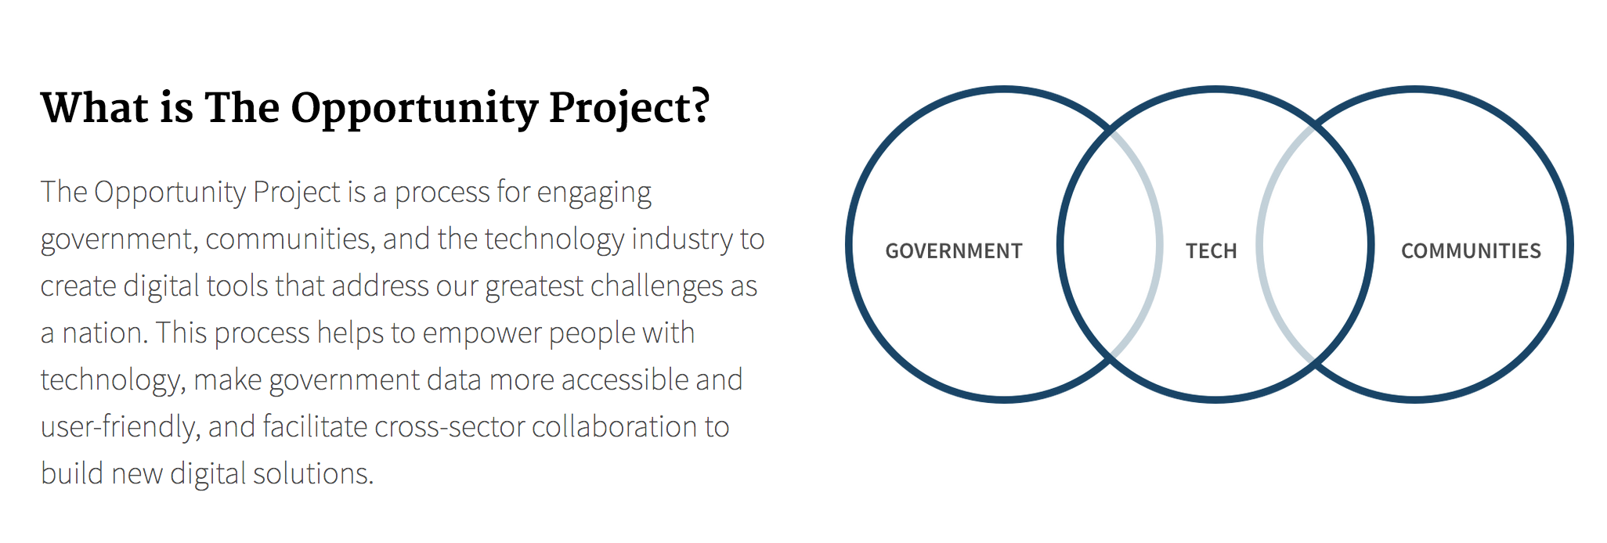
Iterative approach
Collect relevant datasets and code, then funnel through a 12-week (starting Sept.), user-centered agile sprint process to facilitate AI/NLP for an experimental therapy ecosystem.
Demo final tools and showcase data, code on code.gov and other .gov websites.

Slide 31
Summary
Created datasets so can compare different patient-clinical trial matching approaches “apple to apple.”
Clustered results based on Boolean logic and free text with NLP
Found fill-in templates via leveraging Boolean logic for released criteria data and for free text by criteria
Designed framework for incentivizing standardization in criteria using absorption Markov chain approach via consensus score for protocols
Created proof of concept web interface for entering criteria and getting data-based suggestions
Resulted in rectifying issues/suggested changes to: business processes, database API/code, and underlying protocol data.
Now preparing to launch opportunity project to iterate and extend current work.

Slide 32
Acknowledgements
Sheila Prindiville
Gisele Sarosy
Samantha Finstad
Shahin Assefnia
David Loose
Neesha Desai
Sam Isa
Nina Bianchi
Peter Garrett
Nelvis Castro
Mary Anne Bright
Candace Deaton Maynard
Tony Kerlavage
David Patton
Brent Coffey
Anna Steinfeld
Jerry Sheehan
Joshua Di Frances
Paul Fearn
Justin Koufopoulos
Drew Zachary
Kristen Honey
And many more…

Slide 33

Thanks!
Contact: gil.alterovitz@pif.gov and justin.koufopoulos@pif.gov
P R E S I D E N T I A L I N N O V A T I O N F E L L O W S | pif.gov | @innovfellows

